Slide 1

SMART TUTOR
Team members :
Ayesha Siddiqha
Tamanna Kouser .S

Slide 2

SMART TUTOR
Introduction:
Smart Tutor your go-to destination for mastering knowledge through innovative flashcard learning. At Smart Tutor, we believe that learning should be engaging, efficient, and personalized. Our platform offers a vast library of customizable flashcards across various subjects, designed to help you retain information and excel in your studies. Whether you're a student, professional, or lifelong learner, Smart Tutor empowers you to achieve your educational goals with ease. Join our community and transform the way you learn, one flashcard at a time.
TECHNOLOGIES USED:
HTML (version: HTML5)
CSS(version:5.3)
Java Script(version:5.3)
BOOTSTRAP(version: Bootstrap 4.6)
GOOGLE CHROME(version: 119.0.6045.159)
VISUAL STUDIO CODE(version:1.84.2)
Git and Github

Slide 3
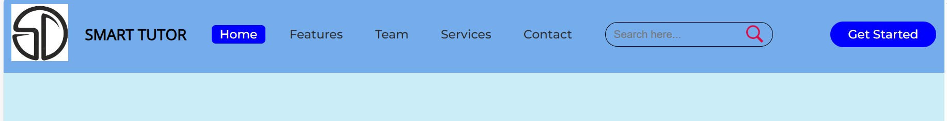
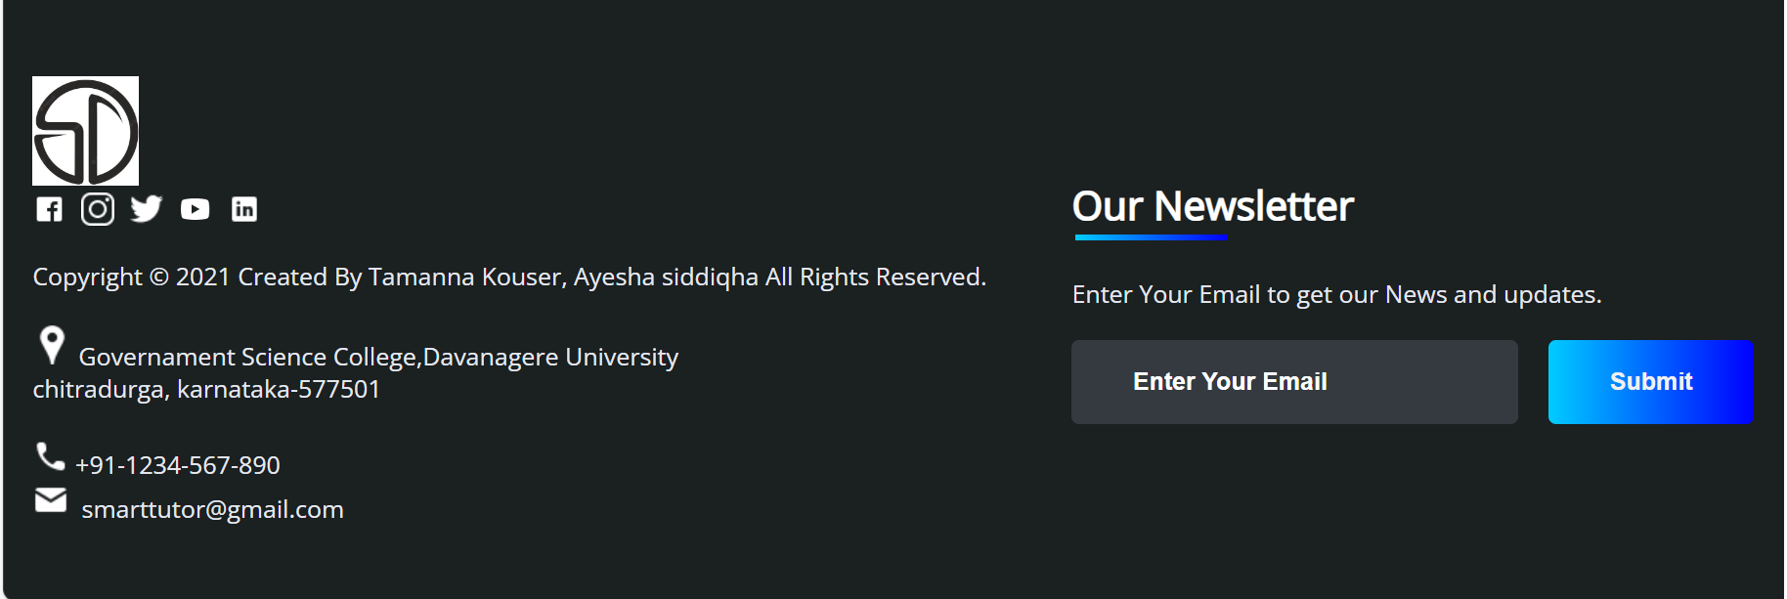
SMART TUTOR
Nav bar:
Footer:

Slide 4

SMART TUTOR
Carousal:

Slide 5
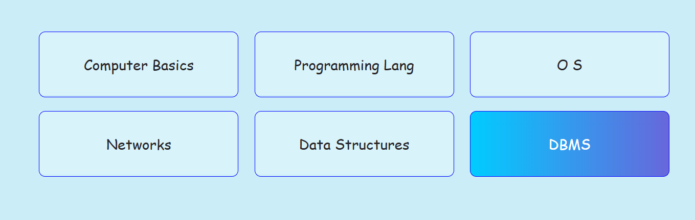
SMART TUTOR
Concepts to Explore:

Slide 6
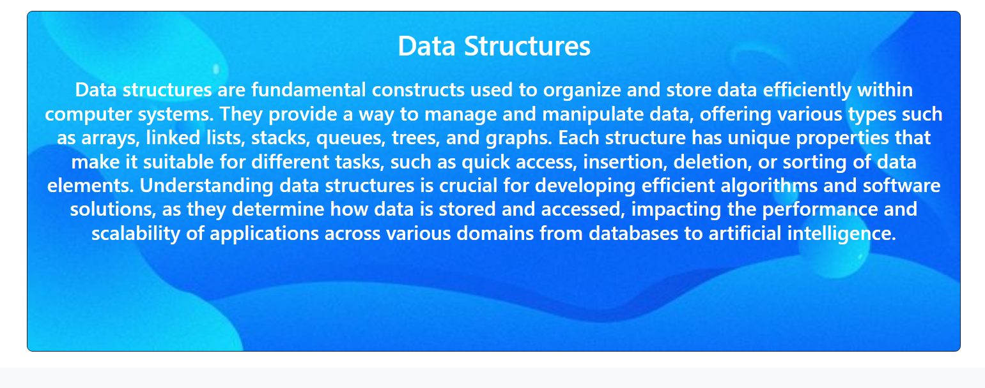
SMART TUTOR
Flash cards and concepts

Slide 7
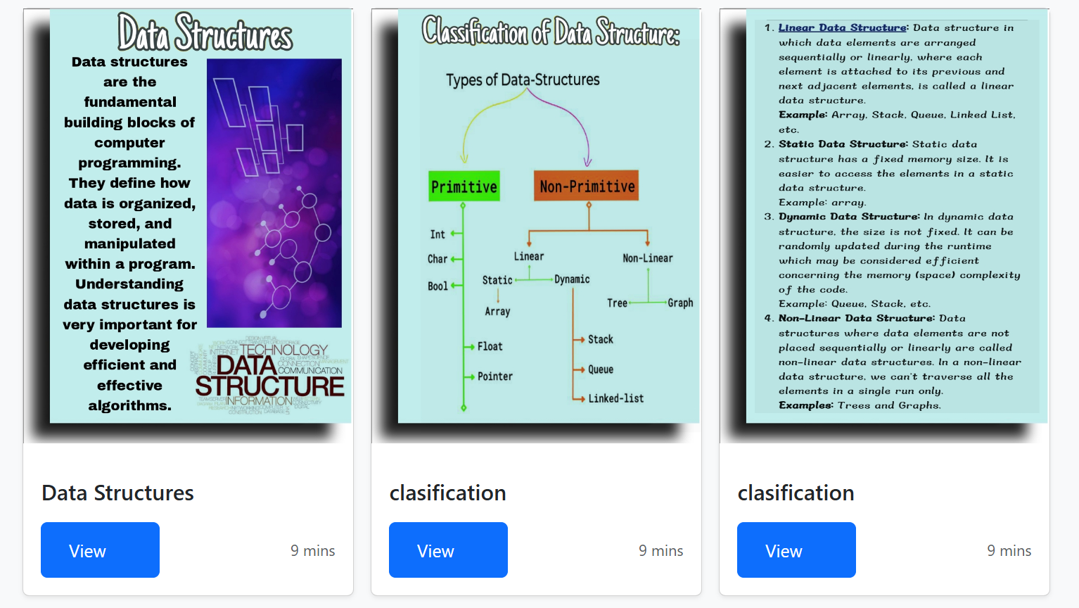
SMART TUTOR
Flash cards:

Slide 8
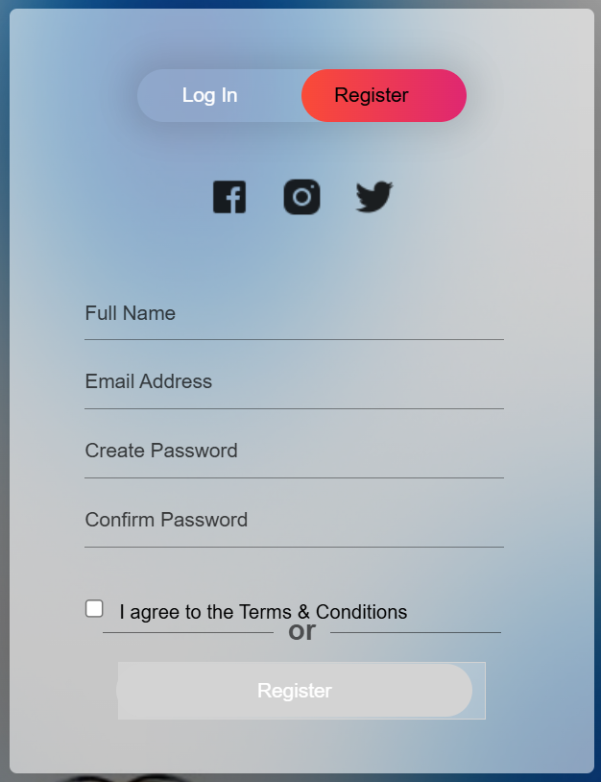
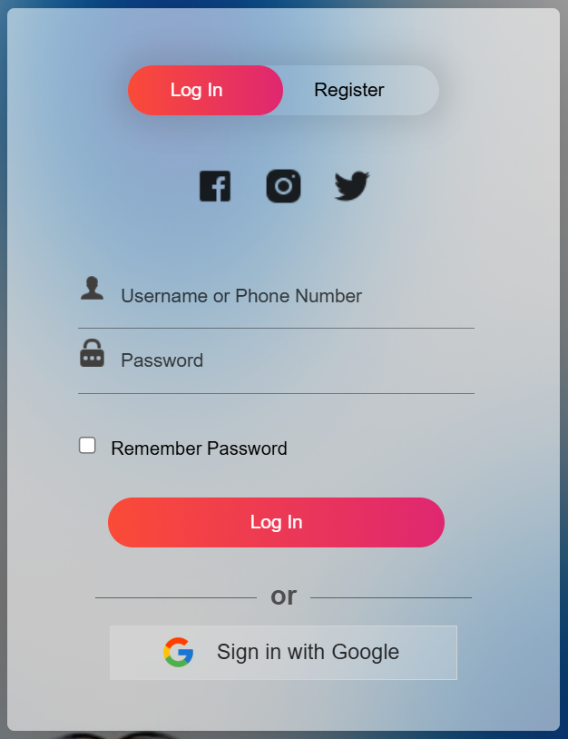
SMART TUTOR
Registration:
Login:

Slide 9
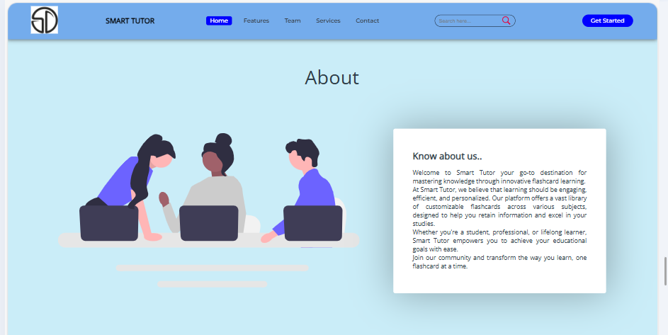
SMART TUTOR
About us:

Slide 10
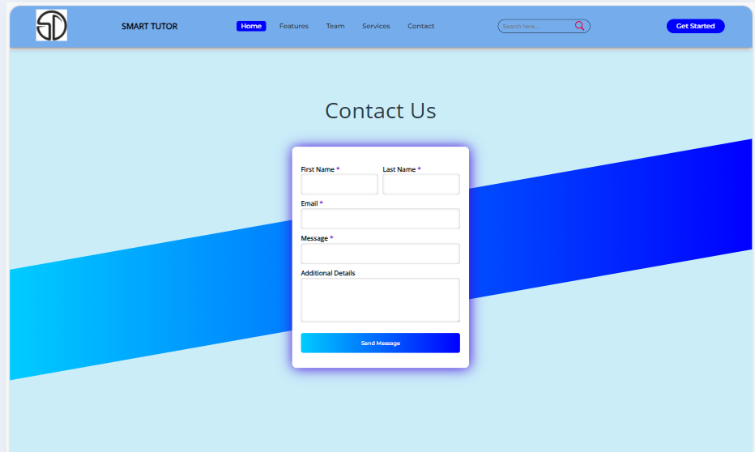
SMART TUTOR
Contact us:

Slide 11
THANK
YOU

